Slide 1


Sundaraselvam P
04-May-2024

Slide 2

Outline
Executive Summary
Introduction
Methodology
Results
Conclusion
Appendix

Slide 3
Executive Summary
Summary of methodologies
This project employed a combination of data collection (SpaceX API, web scraping), data cleaning and preparation, exploratory data analysis (visual and SQL-based), interactive visualization (Folium, Plotly Dash), and machine learning (classification models) to predict the success of SpaceX Falcon 9 first-stage landings.
Summary of all results
Analysis revealed key factors influencing landing success, including launch site, payload mass, and orbit type. The project identified the best performing machine learning model with an accuracy of over 83%, demonstrating the feasibility of predicting landing outcomes.

Slide 4
Introduction
Project background and context
SpaceX's Falcon 9 is a reusable two-stage rocket designed to transport payloads and crew into Earth's orbit and beyond. The ability to land and reuse the first stage significantly reduces launch costs, making space access more affordable.
Problems you want to find answers
This project aims to develop a machine learning model that predicts the success of Falcon 9 first-stage landings based on historical launch data.

Slide 5

Section 1

Slide 6
Methodology
Executive Summary
Data collection methodology:
Describe how data was collected
Perform data wrangling
Describe how data was processed
Perform exploratory data analysis (EDA) using visualization and SQL
Perform interactive visual analytics using Folium and Plotly Dash
Perform predictive analysis using classification models
How to build, tune, evaluate classification models

Slide 7
Data Collection
Describe how data sets were collected.
Launch data was collected from the SpaceX API using Python libraries like 'requests' and 'pandas'. Additionally, web scraping techniques with BeautifulSoup extracted historical launch records from Wikipedia.
You need to present your data collection process use key phrases and flowcharts

Slide 8
Data Collection – SpaceX API
Present your data collection with SpaceX REST calls using key phrases and flowcharts
Add the GitHub URL of the completed SpaceX API calls notebook (“https://github.com/Sundaraselvamp/IBM_Capstone_DS/blob/main/jupyter-labs-spacex-data-collection-api.ipynb”), as an external reference and peer-review purpose
1. Request and parse the SpaceX launch data using the GET request
2. Filter the dataframe to only include Falcon 9 launches
3. Dealing with Missing Values

Slide 9
Data Collection - Scraping
Present your web scraping process using key phrases and flowcharts
Add the GitHub URL of the completed web scraping notebook, as an external reference and peer-review purpose(“https://github.com/Sundaraselvamp/IBM_Capstone_DS/blob/main/jupyter-labs-webscraping.ipynb”)
Request the Falcon9 Launch Wiki page from its URL
Extract all column/variable names from the HTML table header
Create a data frame by parsing the launch HTML tables

Slide 10
Data Wrangling
Data cleaning involved handling missing values, converting data types, and creating new features like 'landing\_class' to indicate successful (1) or unsuccessful (0) landings. Feature engineering techniques were applied to prepare the data for machine learning.
Calculate the number of launches on each site
Calculate the number and occurrence of each orbit
Calculate the number and occurence of mission outcome of the orbits
Create a landing outcome label from Outcome column
GitHub URL: https://github.com/Sundaraselvamp/IBM_Capstone_DS/blob/main/labs-jupyter-spacex-Data%20wrangling.ipynb

Slide 11
EDA with Data Visualization
Several visualizations were created to explore relationships between variables: scatter plots for Flight Number vs. Launch Site and Payload vs. Launch Site, bar charts for success rate by Orbit type, and line charts for yearly average success rate. These visualizations helped uncover patterns and trends in the data.
GitHub URL : https://github.com/Sundaraselvamp/IBM_Capstone_DS/blob/main/edadataviz.ipynb

Slide 12
EDA with SQL
Key SQL queries performed, such as;
Finding the names of unique launch sites.
Calculating the total payload mass carried by boosters from NASA (CRS).
Analyzing the average payload mass carried by booster version F9 v1.1.
Determining the date of the first successful ground pad landing.
Listing boosters that successfully landed on drone ships with specific payload mass ranges.
Analyzing the distribution of successful and failed mission outcomes.
Identifying the booster versions with the maximum payload mass.
Exploring launch records from 2015 with failed drone ship landings.
Ranking landing outcomes between specific dates.
GitHub URL: https://github.com/Sundaraselvamp/IBM_Capstone_DS/blob/main/jupyter-labs-eda-sql-coursera_sqllite%20(1).ipynb

Slide 13
Build an Interactive Map with Folium
An interactive map was built using Folium to visualize launch site locations and their proximities to various features. Markers indicate launch sites, color-coded by success/failure outcomes. Distance calculations and lines illustrate the proximity of each site to coastlines, railways, highways, and cities, providing insights into potential geographic factors influencing landing success.
GitHub URL: https://github.com/Sundaraselvamp/IBM_Capstone_DS/blob/main/lab_jupyter_launch_site_location.ipynb

Slide 14
Build a Dashboard with Plotly Dash
A Plotly Dash dashboard was developed to facilitate interactive exploration of the data. The dashboard includes pie charts showing launch success counts for different sites, and scatter plots of Payload vs. Launch Outcome with range sliders for filtering by payload mass. This interactive visualization allows for deeper understanding of the relationship between payload and landing success for various launch sites and booster versions.

Slide 15
Predictive Analysis (Classification)
Several classification models were built and tuned to predict landing outcomes: Logistic Regression, Support Vector Machine (SVM), Decision Tree, and K-Nearest Neighbors (KNN). GridSearchCV optimized hyperparameters for each model. Evaluation metrics like accuracy and confusion matrices were used to select the best performing model
GitHub URL: https://github.com/Sundaraselvamp/IBM_Capstone_DS/blob/main/SpaceX_Machine%20Learning%20Prediction_Part_5.ipynb

Slide 16
Results
Exploratory data analysis results
Interactive analytics demo in screenshots
Predictive analysis results

Slide 17

Section 2

Slide 18
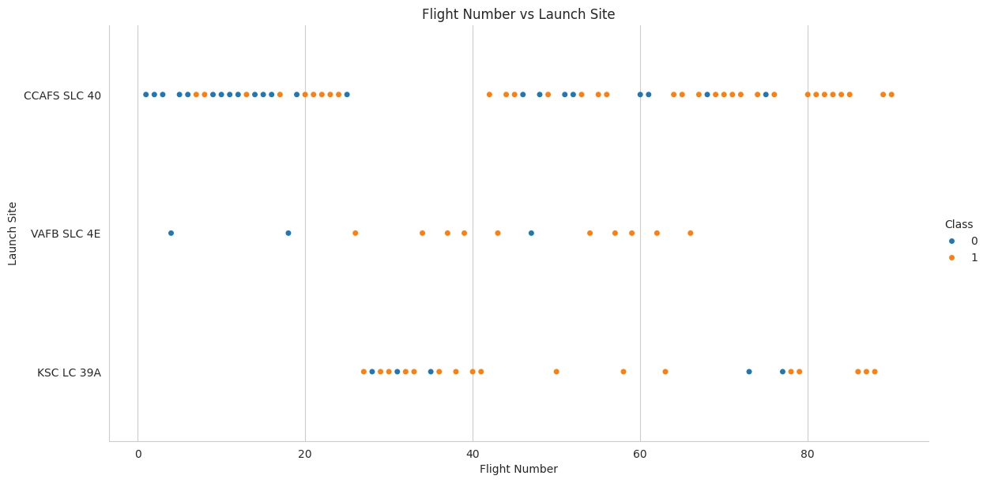
Flight Number vs. Launch Site

Slide 19
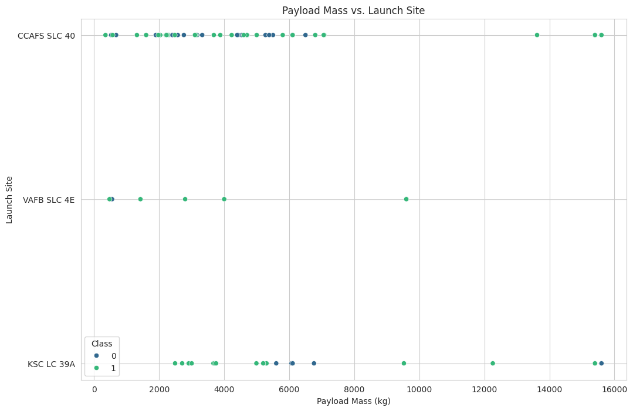
Payload vs. Launch Site

Slide 20
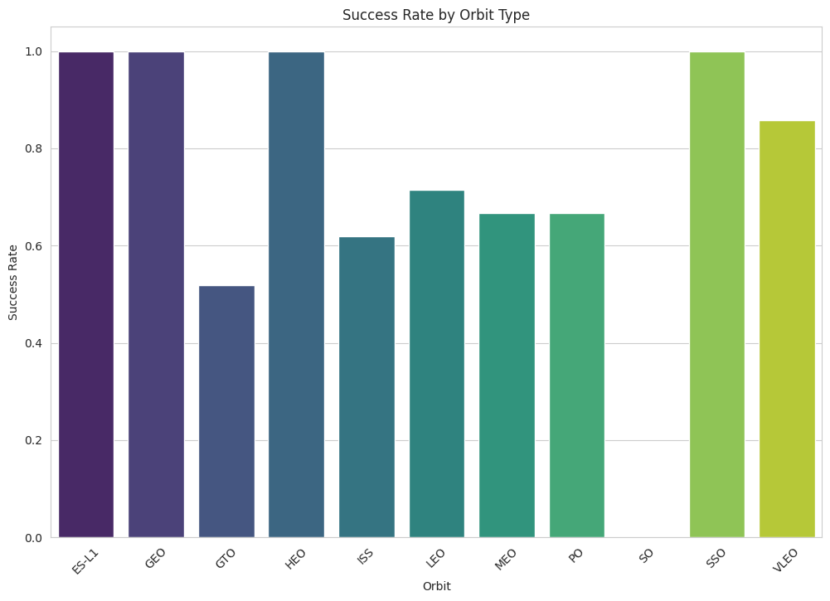
Success Rate vs. Orbit Type

Slide 21
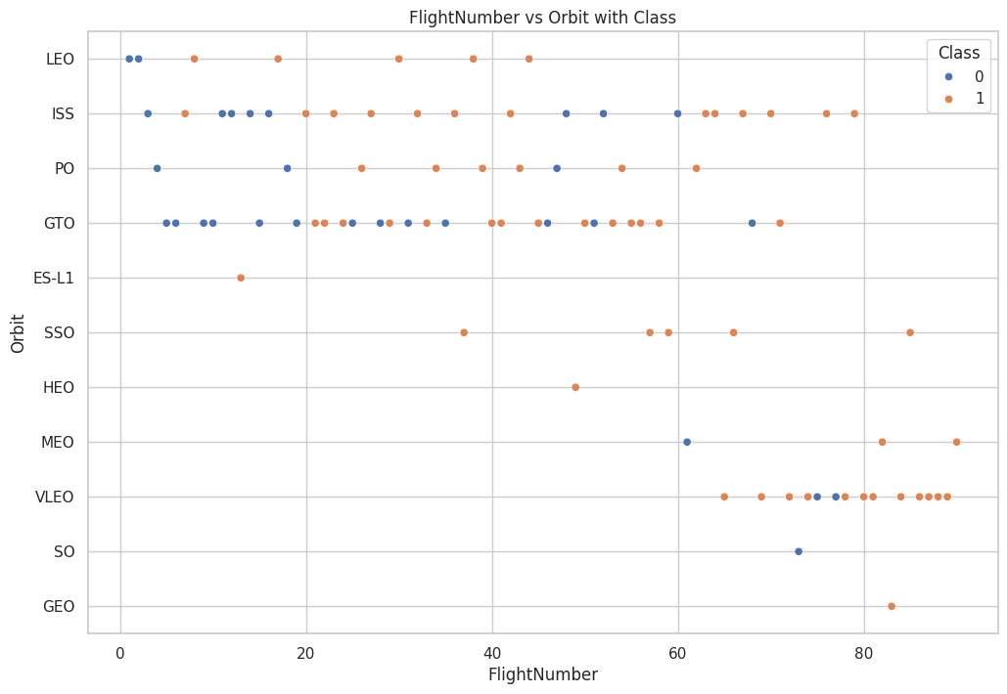
Flight Number vs. Orbit Type

Slide 22
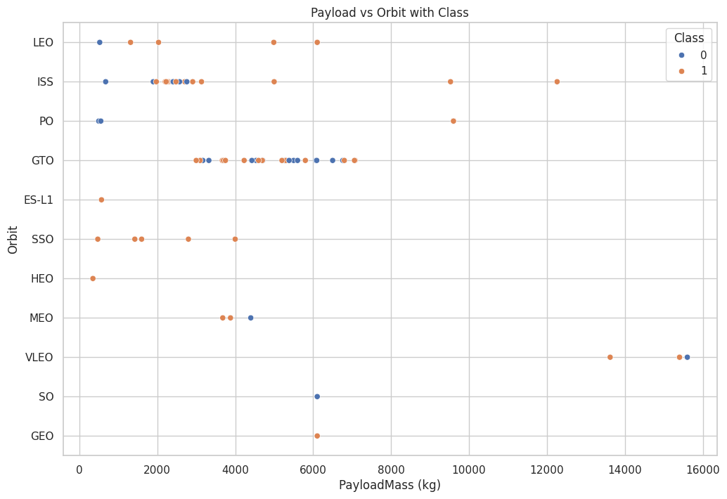
Payload vs. Orbit Type

Slide 23
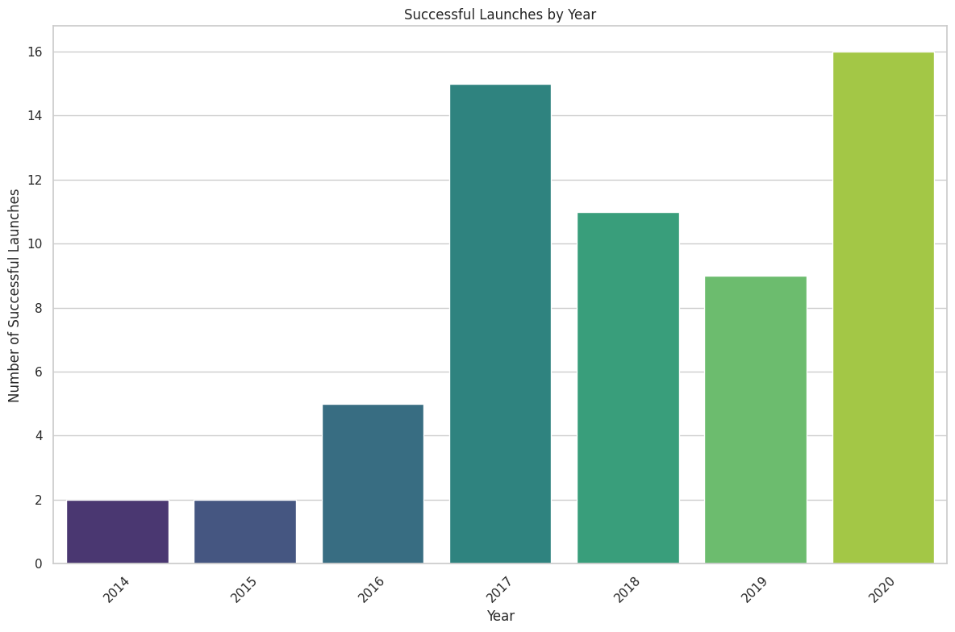
Launch Success Yearly Trend

Slide 24
All Launch Site Names
CCAFS LC-40
VAFB SLC-4E
KSC LC-39A
CCAFS SLC-40

Slide 25
Launch Site Names Begin with 'CCA'
Date | Time (UTC) | Booster_Version | Launch_Site | Payload | PAYLOAD_MASS__KG_ | Orbit | Customer | Mission_Outcome | Landing_Outcome
2010-06-04 | 18:45:00 | F9 v1.0 B0003 | CCAFS LC-40 | Dragon Spacecraft Qualification Unit | 0 | LEO | SpaceX | Success | Failure (parachute)
2010-12-08 | 15:43:00 | F9 v1.0 B0004 | CCAFS LC-40 | Dragon demo flight C1, two CubeSats, barrel of Brouere cheese | 0 | LEO (ISS) | NASA (COTS) NRO | Success | Failure (parachute)
2012-05-22 | 7:44:00 | F9 v1.0 B0005 | CCAFS LC-40 | Dragon demo flight C2 | 525 | LEO (ISS) | NASA (COTS) | Success | No attempt
2012-10-08 | 0:35:00 | F9 v1.0 B0006 | CCAFS LC-40 | SpaceX CRS-1 | 500 | LEO (ISS) | NASA (CRS) | Success | No attempt
2013-03-01 | 15:10:00 | F9 v1.0 B0007 | CCAFS LC-40 | SpaceX CRS-2 | 677 | LEO (ISS) | NASA (CRS) | Success | No attempt

Slide 26
Total Payload Mass
Total Payload Mass NASA CRS=48213

Slide 27
Average Payload Mass by F9 v1.1
Average payload mass carried by booster version F9 v1.1=2534.6666666666665

Slide 28
First Successful Ground Landing Date
Dates of the first successful landing outcome on ground pad(2015-12-22)

Slide 29
Successful Drone Ship Landing with Payload between 4000 and 6000
List the names of boosters which have successfully landed on drone ship and had payload mass greater than 4000 but less than 6000
F9 FT B1022
F9 FT B1026
F9 FT B1021.2
F9 FT B1031.2

Slide 30
Total Number of Successful and Failure Mission Outcomes
The total number of successful and failure mission outcomes
Mission_Outcome | Total
Failure (in flight) | 1
Success | 98
Success | 1
Success (payload status unclear) | 1

Slide 31
Boosters Carried Maximum Payload
Names of the booster which have carried the maximum payload mass
F9 B5 B1048.4
F9 B5 B1049.4
F9 B5 B1051.3
F9 B5 B1056.4
F9 B5 B1048.5
F9 B5 B1051.4
F9 B5 B1049.5
F9 B5 B1060.2
F9 B5 B1058.3
F9 B5 B1051.6
F9 B5 B1060.3
F9 B5 B1049.7

Slide 32
2015 Launch Records
List the failed landing_outcomes in drone ship, their booster versions, and launch site names for in year 2015
Month | Landing_Outcome | Booster_Version | Launch_Site
01 | Failure (drone ship) | F9 v1.1 B1012 | CCAFS LC-40
04 | Failure (drone ship) | F9 v1.1 B1015 | CCAFS LC-40

Slide 33
Rank Landing Outcomes Between 2010-06-04 and 2017-03-20
Landing_Outcome | Count_of_Landing_Outcomes
No attempt | 10
Success (drone ship) | 5
Failure (drone ship) | 5
Success (ground pad) | 3
Controlled (ocean) | 3
Uncontrolled (ocean) | 2
Failure (parachute) | 2
Precluded (drone ship) | 1

Slide 34

Section 3

Slide 35
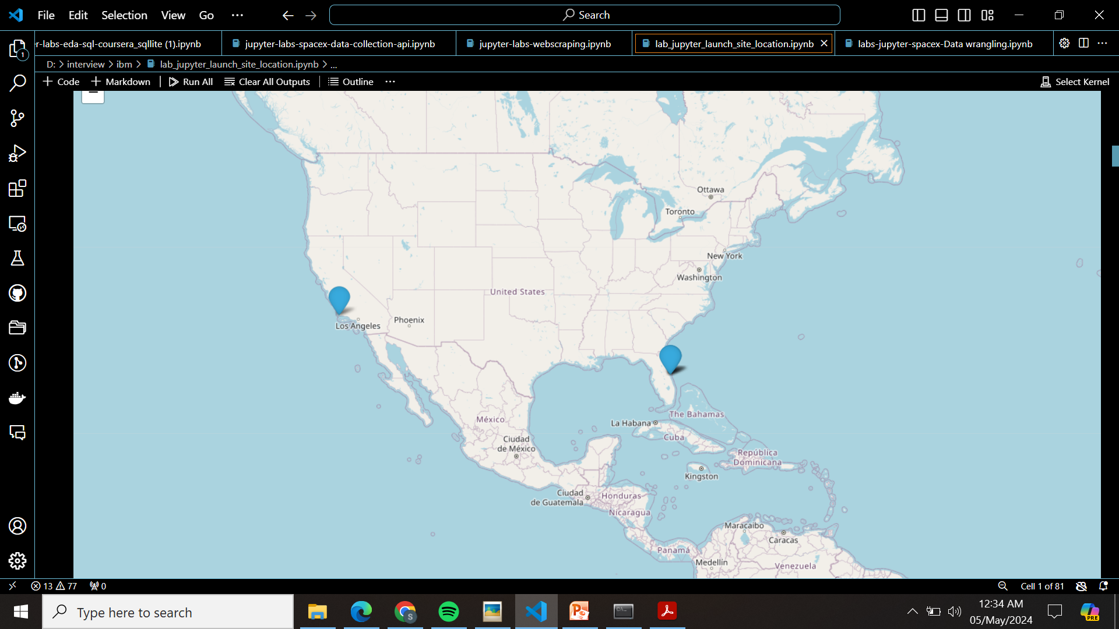
<Folium Map Screenshot 1>

Slide 36
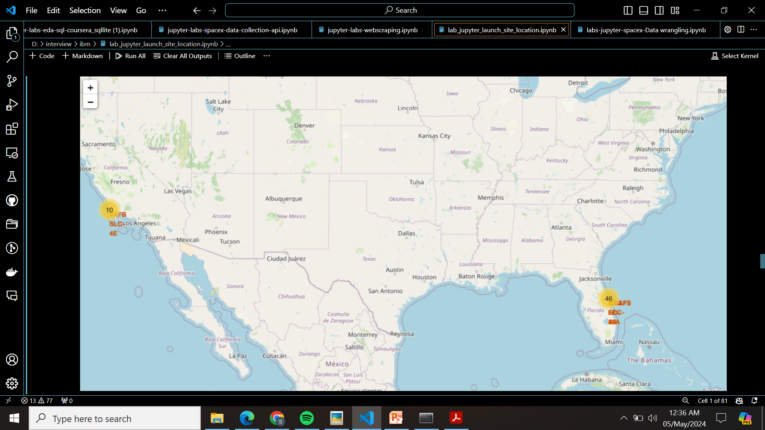
<Folium Map Screenshot 2>

Slide 37
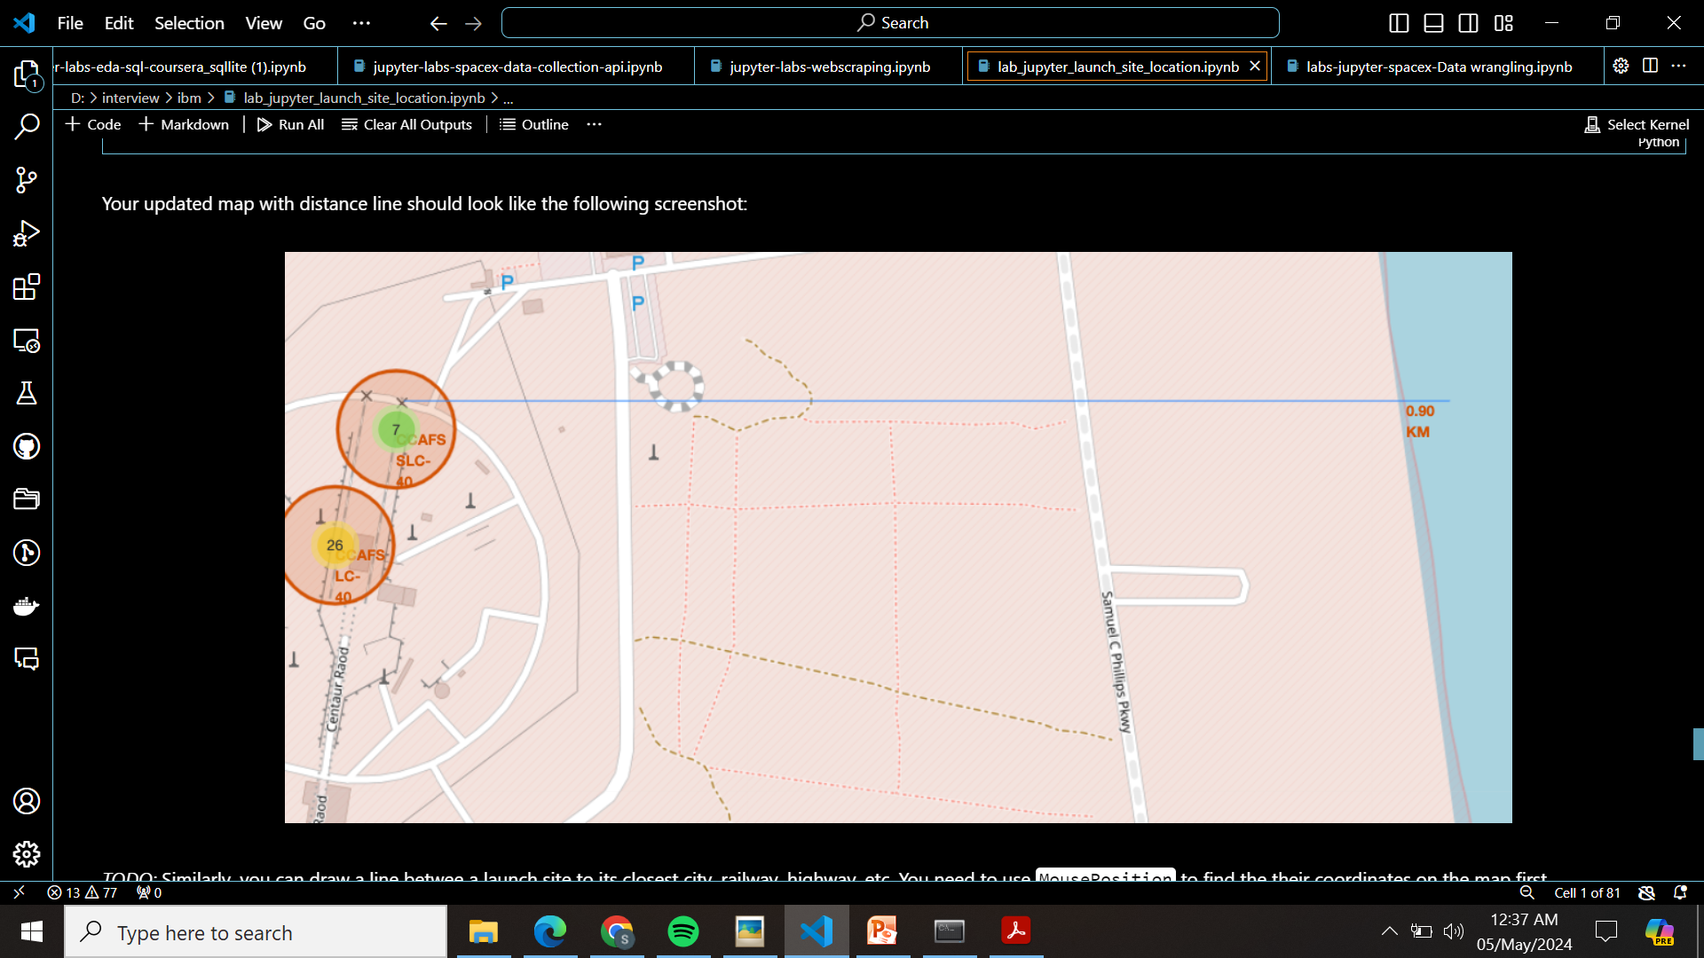
<Folium Map Screenshot 3>

Slide 38

Section 4

Slide 39
<Dashboard Screenshot 1>
Replace <Dashboard screenshot 1> title with an appropriate title
Show the screenshot of launch success count for all sites, in a piechart
Explain the important elements and findings on the screenshot

Slide 40
<Dashboard Screenshot 2>
Replace <Dashboard screenshot 2> title with an appropriate title
Show the screenshot of the piechart for the launch site with highest launch success ratio
Explain the important elements and findings on the screenshot

Slide 41
<Dashboard Screenshot 3>
Replace <Dashboard screenshot 3> title with an appropriate title
Show screenshots of Payload vs. Launch Outcome scatter plot for all sites, with different payload selected in the range slider
Explain the important elements and findings on the screenshot, such as which payload range or booster version have the largest success rate, etc.

Slide 42

Section 5

Slide 43
Classification Accuracy
The bar chart presents the accuracy of each classification model on the test data. The Decision Tree and Logistic Regression models achieved the highest accuracy of 83.33%, outperforming SVM and KNN.

Slide 44

Confusion Matrix
The confusion matrix shows that the Decision Tree model correctly predicted 15 out of 18 instances. It had difficulty with some false positives, where unsuccessful landings were predicted as successful. Further analysis and feature engineering could potentially improve the model's performance.

Slide 45
Conclusions
The project successfully built and evaluated machine learning models for predicting SpaceX Falcon 9 first-stage landing success. Key factors influencing landing outcomes were identified, including launch site, payload mass, and orbit type. The best performing model achieved an accuracy of over 83%, demonstrating the feasibility of this approach.
Future work could explore additional features, such as weather conditions, and experiment with other machine learning models like ensemble methods. Additionally, developing a real-time prediction system could provide valuable insights for future launches.

Slide 46
Appendix
Include any relevant assets like Python code snippets, SQL queries, charts, Notebook outputs, or data sets that you may have created during this project

Slide 47


